Slide 1
Case study – ENPI CBC and marine environment
Tallinn 30 November 2017

Slide 2
Case study
ENVIRONMENTAL OBJECTIVE IN THE THREE PROGRAMMES
Basin | Specific Environmental Objectives | % projects * | %€*
MED | Priority 2 “Promotion of environmental sustainability at the basin level” Measure 2.1: Prevention and reduction of risk factors for the environment and enhancement of natural common heritage; Measure 2.2: Promotion of renewable energy use and improvement of energy efficiency contributing to addressing, among other challenges, climate change | 43% | 49%
Black sea | Priority 2 “Promotion of sustainable development” Measure 2.1: Efficient management of natural resources in agriculture and fishery; Measure 2.2: Enhancement of natural and cultural heritage; Measure 2.3: Development of sustainable energy. | 44% | 49%
Italy-Tunisia | Priority 2: “Sharing resources and competencies for environmental protection and conservation” Measure 2.1 - Strengthening the joint knowledge and information base needed to address common challenges in the environmental protection of river and maritime systems; Measure 2.2 - Promoting research, innovation and awareness in the field of conservation and environmental protection for protected natural areas; Measure 2.3 - Promotion of cooperation initiatives aimed at innovation in technologies and management of solid waste and wastewater management systems. | 26% | 26%
*with a direct or indirect environmental dimension (not related only to environmental objectives)
Programmes analysed: ENPI CBC Black Sea Basin, ENPI CBC Med, ENPI CBC Italy-Tunisia

Slide 3
Case study
ENVIRONMENTAL CONTEXT IN SEA BASIN
Basin | Fish stocks | Water quality | Climate change | Biodiversity | Population
Mediterranean | 91% of stocks for which an assessment has been done are overfished | Only localized phenomena of pollution | Hot spot with different problems: drought, sea-level rise, rise in temperature. | High diversity of species. Some risks from invasive species | High concentration of population along coasts (143 million people in border countries)
Black sea | Most species fished beyond biologically sustainable limits | Pollution from nutrients is relevant but stable recent years. | Warming of sea surface lower than the global average | Deterioration of diversity in species because of human pressure | A population of 66.9 million people lives in countries along the coasts of the Black Sea
Programmes analysed: ENPI CBC Black Sea Basin, ENPI CBC Med, ENPI CBC Italy-Tunisia

Slide 4
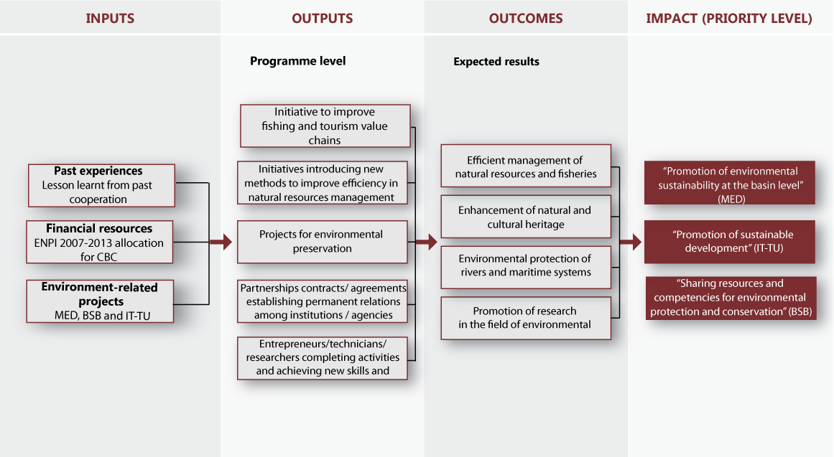
PROGRAMME INTERVENTION LOGIC – marine interventions

Slide 5
Case study – Environment
OVERVIEW OF MARINE PROJECTS

Slide 6
Case study – field-visit projects
Project | Thematic | Budget € | Programme
REEFS | Artificial Reefs | 758,660.47 | BSB
SRCSSMBSF | Fishing stock measurement | 380,271.05 | BSB
BIOVEQ | Halieutic resources exploitation | 1.721.990,40 | IT-TU
CBA | Marine Local fishing management | 774.427,00 | IT-TU
JellyRisk | Marine ecosystem | 2.593.194,23 | MED
M-3HABs | Marine ecosystem | 1.798.254,00 | MED

Slide 7
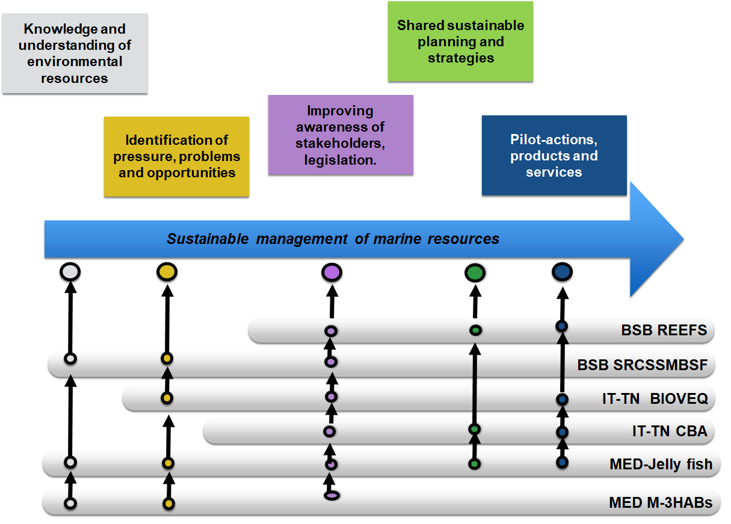
Case study – Environment
PROJECT OUTCOMES

Slide 8
Case study – Environment
KEY FINDINGS
Relevance and strategy design | Correct geographical scale to address current key environmental issues High share of their budget to environmental issues Clear issue related to the legislative context in partner countries
Efficiency | Administrative burden at national (legislative), programme (monitoring) and EU level (use of PRAG) Frequent difficulty in the transferring of funds from third-country partners to the EU
Effectiveness | Achievements are mostly measured through output indicators instead of results Most analysed projects were research-oriented with the objective of increasing knowledge Intangible results: enhancement of management capacity, improvement of decision-making
Impact | Financial allocation is insufficient to produce impacts considering the marine environmental issues Produced changes could be analysed only at very small scales Larger tangible impacts in the long term are more hypothetical and difficult to measure
Sustainability | An exit strategy was absent in most of the projects analysed, challenges with projects follow-up Partners from third countries will participate again in ENI or other EU financial instruments, also as LP
Added value | Cross-border partnership established within the projects was appreciated (networking, knowledge transfer, economy of scale, supporting activities between partners and pilot results obtained) partnerships were perceived as well balanced

Slide 9
Case study – Environment
RECOMMENDATIONS
Identify key environmental issues for each programme, providing a clear theory of change of interventions, with identification of indicators and targets which illustrate expected results and impacts
More concentration of financial resources on measures addressing overfishing, marine ecosystems and biodiversity as a priority in Sea-basin and marine programmes
Select projects with indicators and targets consistent with programme objectives and with a clear exit strategy
Select research projects with evident and demonstrable long-term sustainable impacts across the borders. Projects with evident, long-term and sustainable socio-economic impacts should be given financing priority.
Support governments and local authorities in partner countries through dedicated technical assistance, making the normative context more responsive to cooperation projects

Slide 10
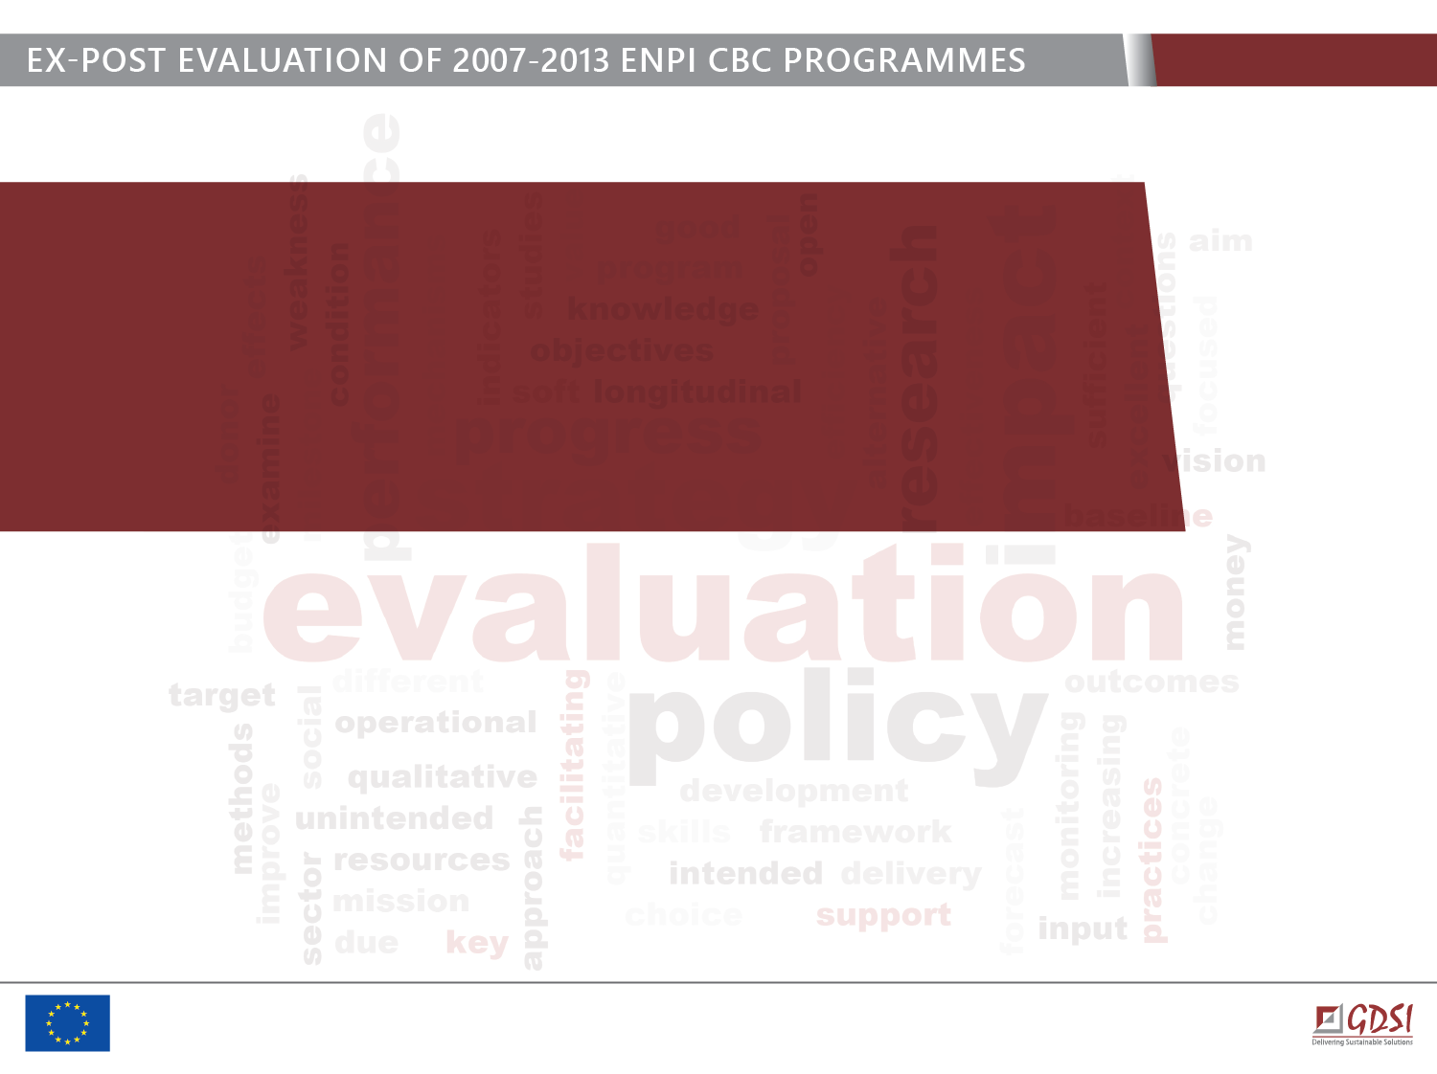
Thank you for your attention!
Address: GDSI Limited, Block 15, Galway Technology Park
Parkmore, Galway, Ireland
Tel.: +353 91 761000
E-mail: consulting@gdsi.ie
Web: www.gdsi.ie

